Slide 1
coreset

Slide 2
The problem of big datasets
Machin learning’s fuel is data. More data, better training, better model. Right?
To big dataset can make the training process long, sometimes a week or more.
It makes the training expensive, very expensive, up to few million dollars.
Consume a lot of energy, one training can consume a few times the yearly consumption of a western citizens.

Slide 3
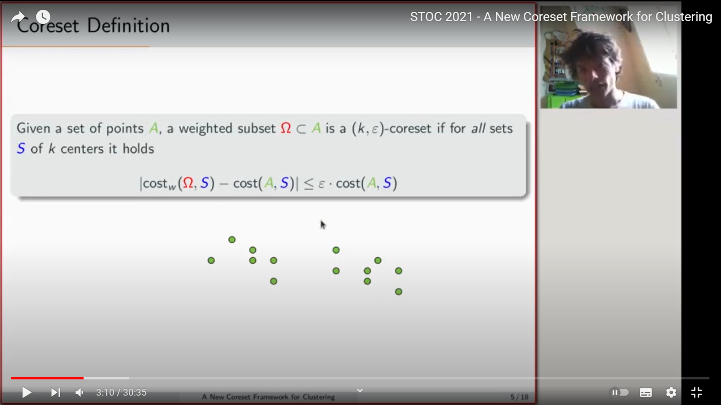
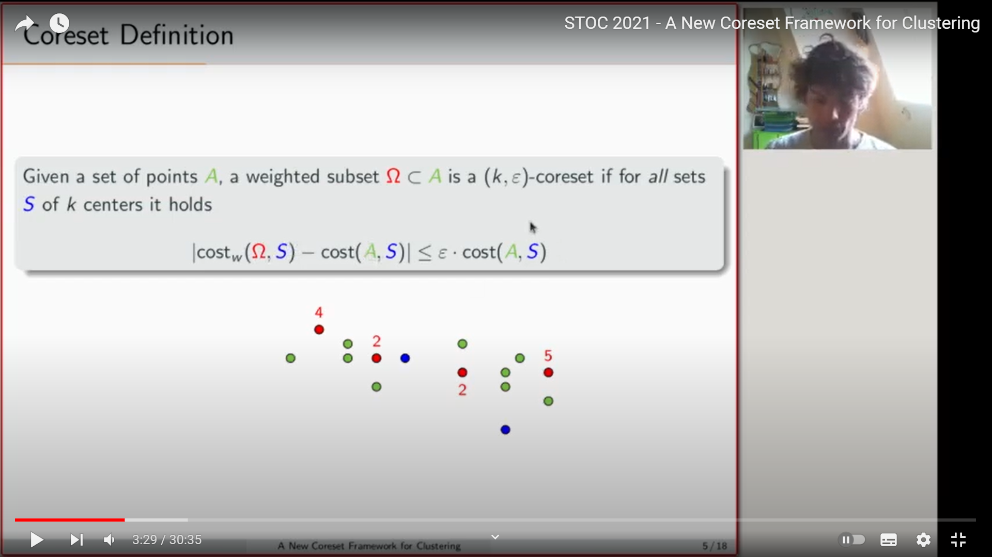
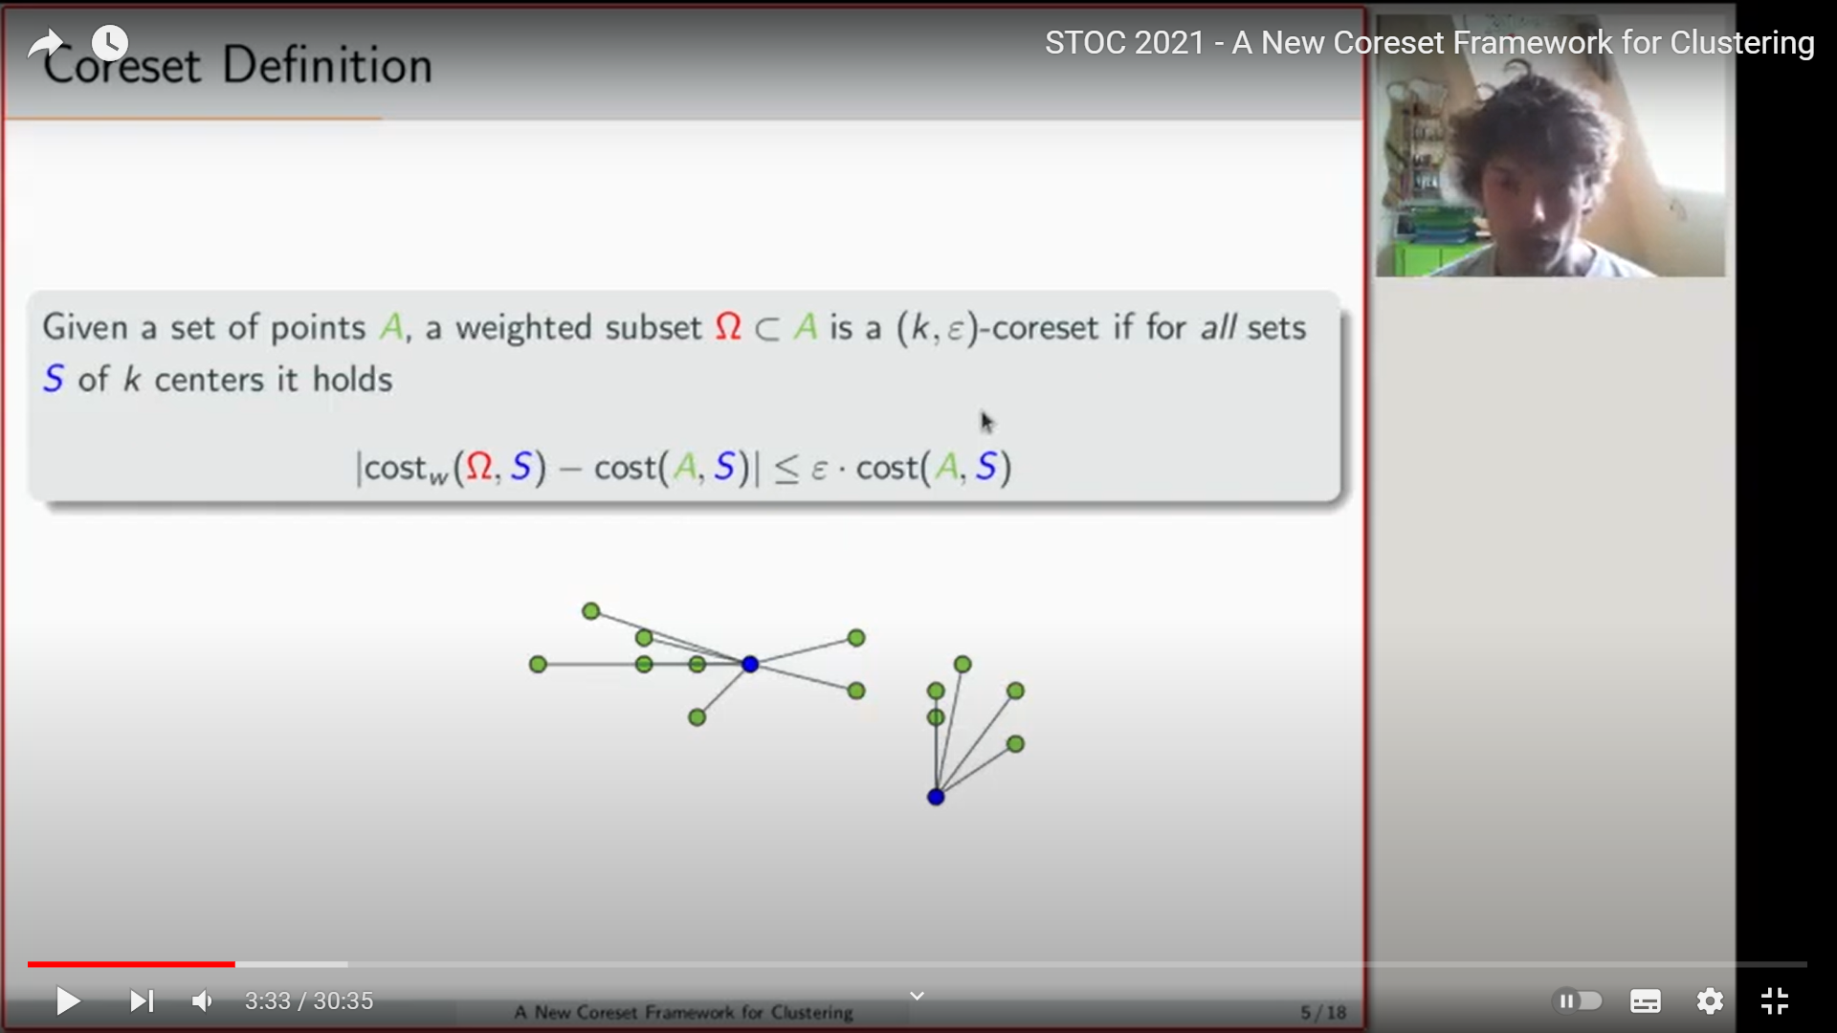
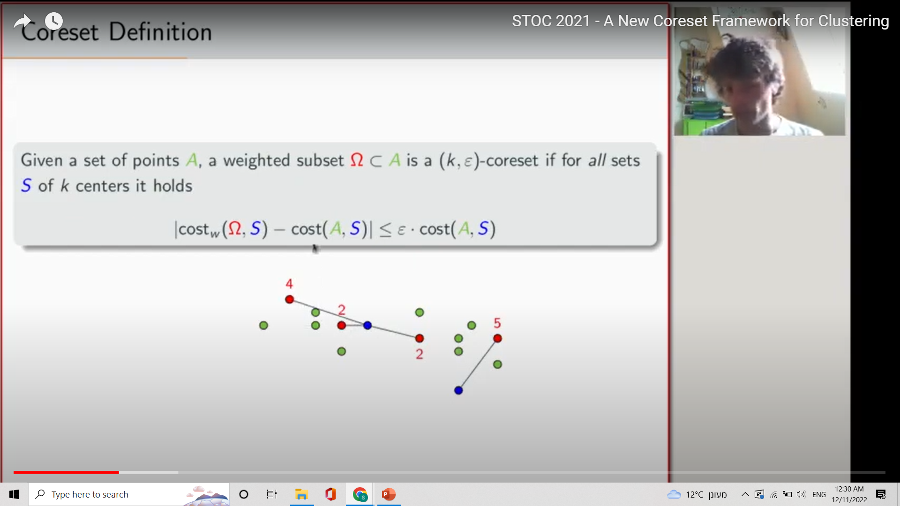
What is Coreset?
Simply, Coreset is an algorithm for making big datasets smaller.
The input is the hole dataset or new data added to the existing dataset. The output is a small number of points, each one accompanied by a weight.
The definition:
As some of you might notice, in some cases there might be infinite solutions so the the problem isn’t as simple as it seems.
There are a lot of different types of Coreset, in this lecture I will talk about the main idea of Coreset and give one example in more depth.

Slide 4
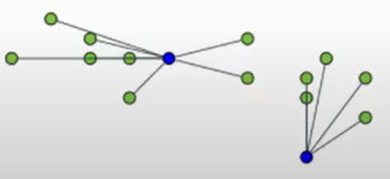
In detail:
For this set of points
While the cost is the
Euclidean distance
The representing pointes (in red) the sum of the wights times the distances from the centers (the cost of the red points)
Will be roughly equal to the to the sum of distances between all the points and the centers.
For every set of k centers (in blue k=2)

Slide 5
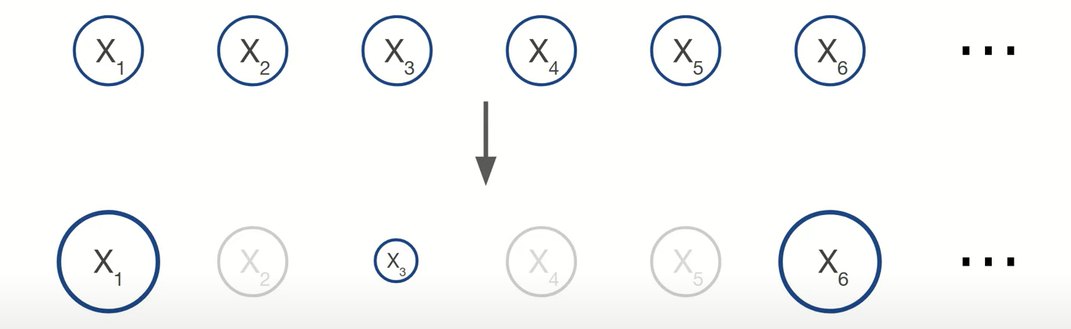
Simply
It takes the hole dataset
Compresses it
Into smaller dataset with weights
Some points get low weights
Some points get high weights

Slide 6
The process in general
First cluster the dataset in one way or another. There is verity between the methods.
Finding the prechosen M number of points the gives the minimal error (matured in a predefined way that hopefully fits the machine learning model well.
Use a statistical model to represent the clusters by one point with a weight.
Use the new Coreset instead of the hole dataset.

Slide 7
The math behind it
There is a lot of mathematical methods of Coreset.
Each one is different so it is very important to choose a Coreset model that will suit your machine learning model well.
Good fit between the Coreset method and the machine learning model can save millions of dollars and even sometime might increase the accuracy of your model.
Good Coreset can be millions of times smaller then the original dataset.

Slide 8
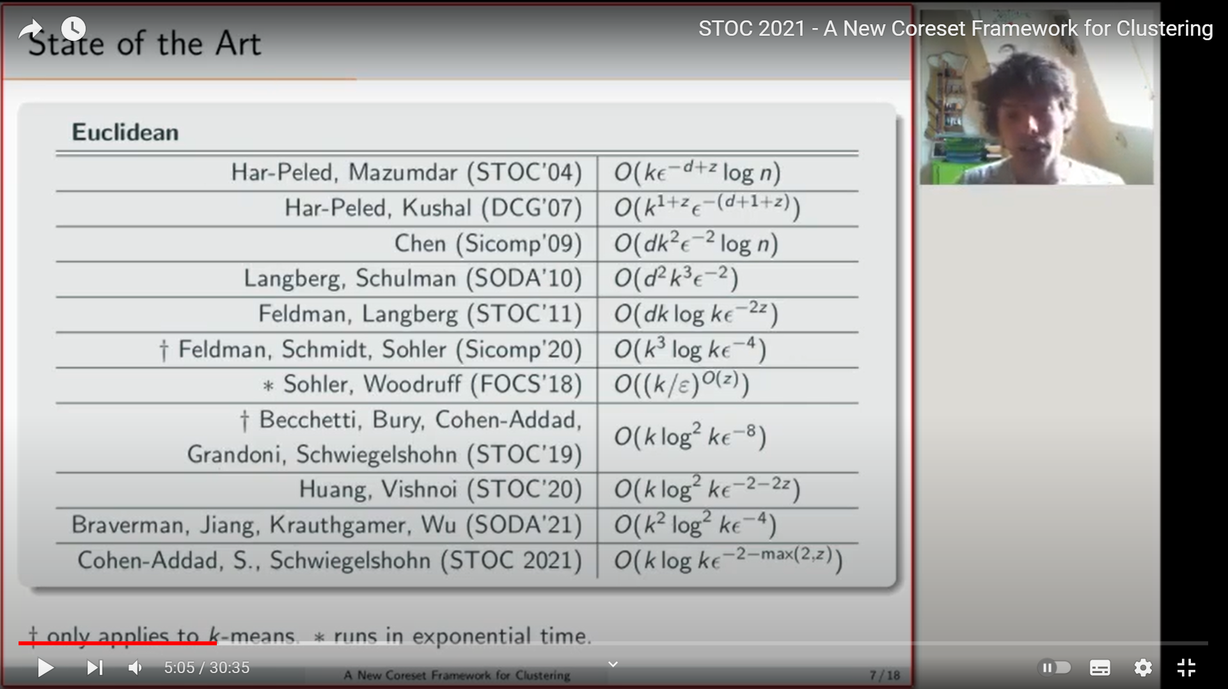
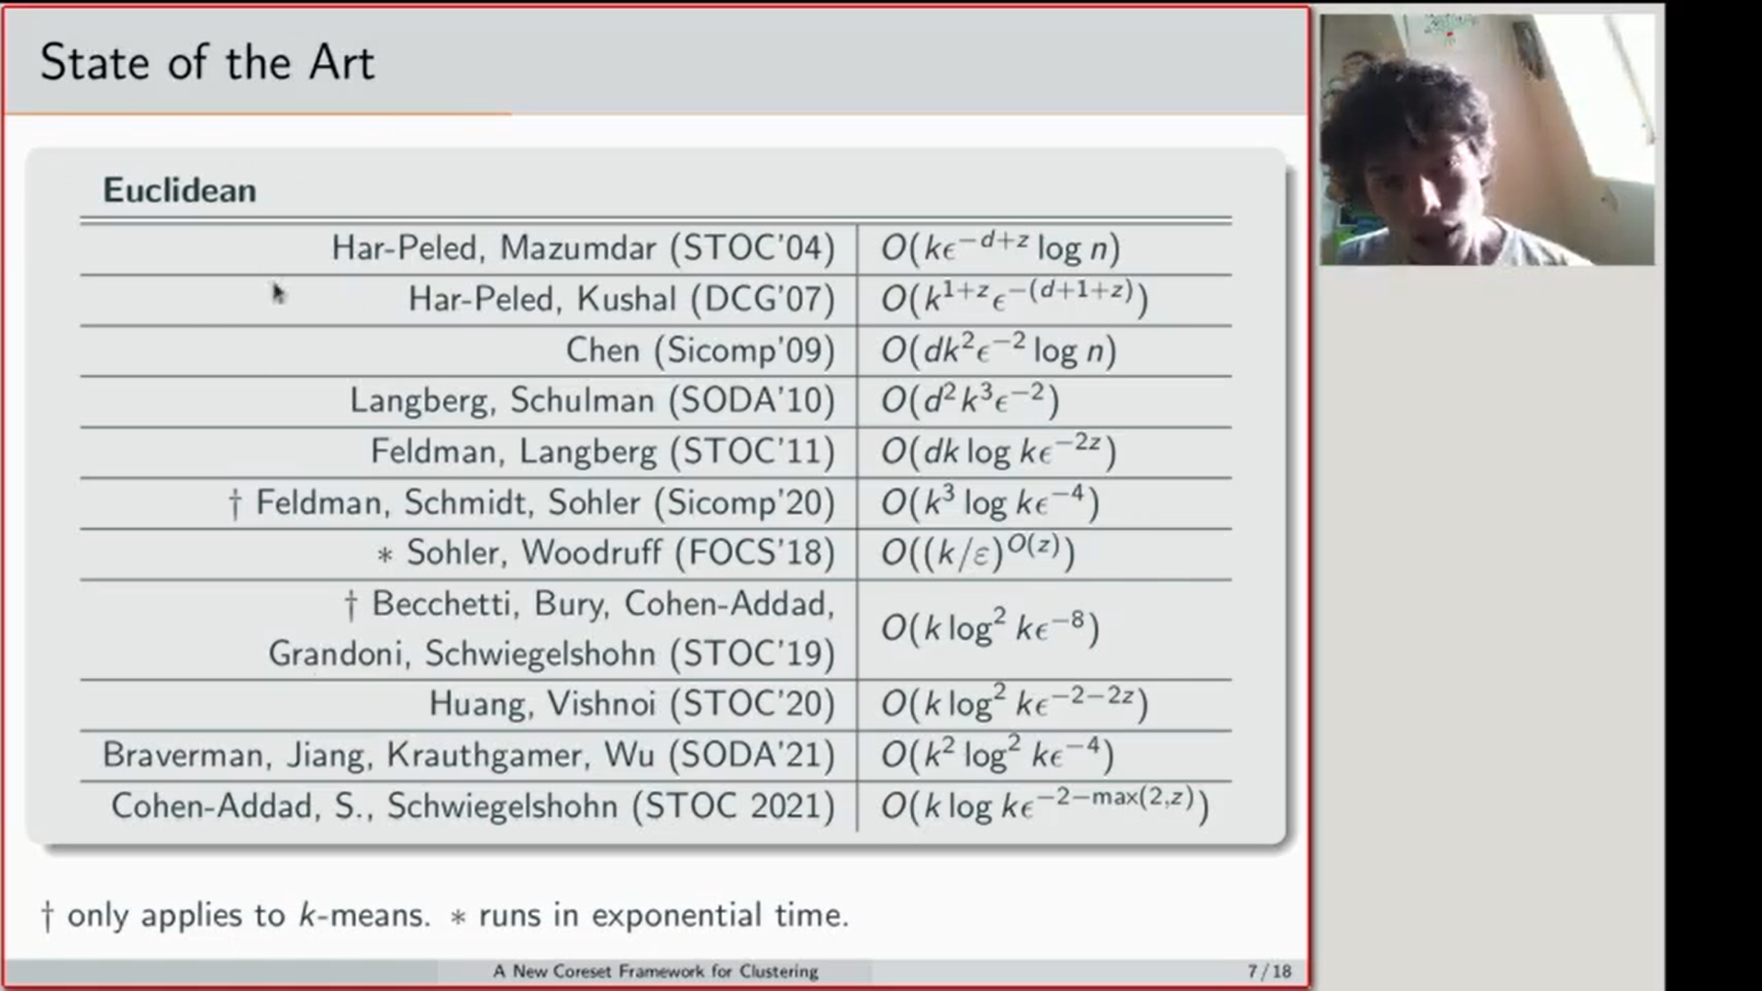
Some examples

Slide 9
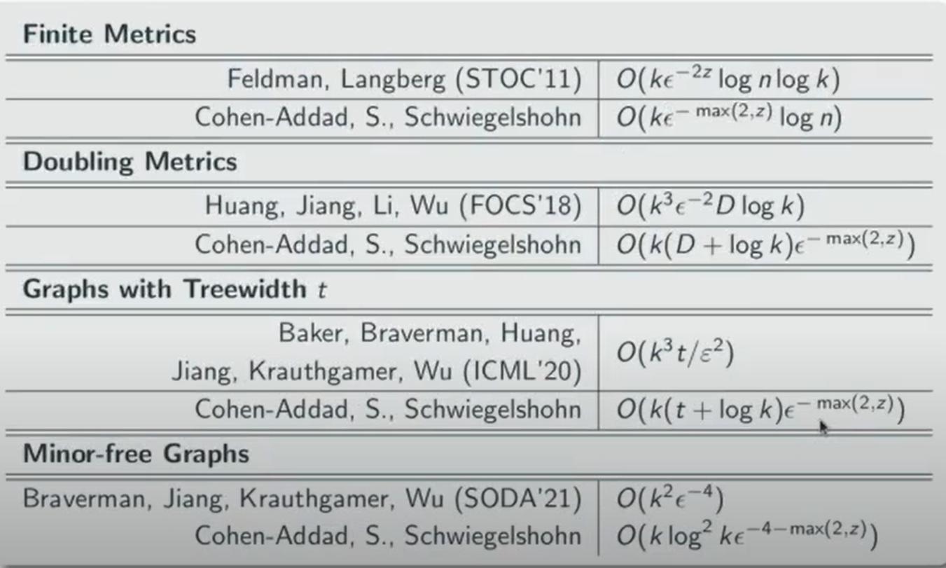
Some more examples

Slide 10
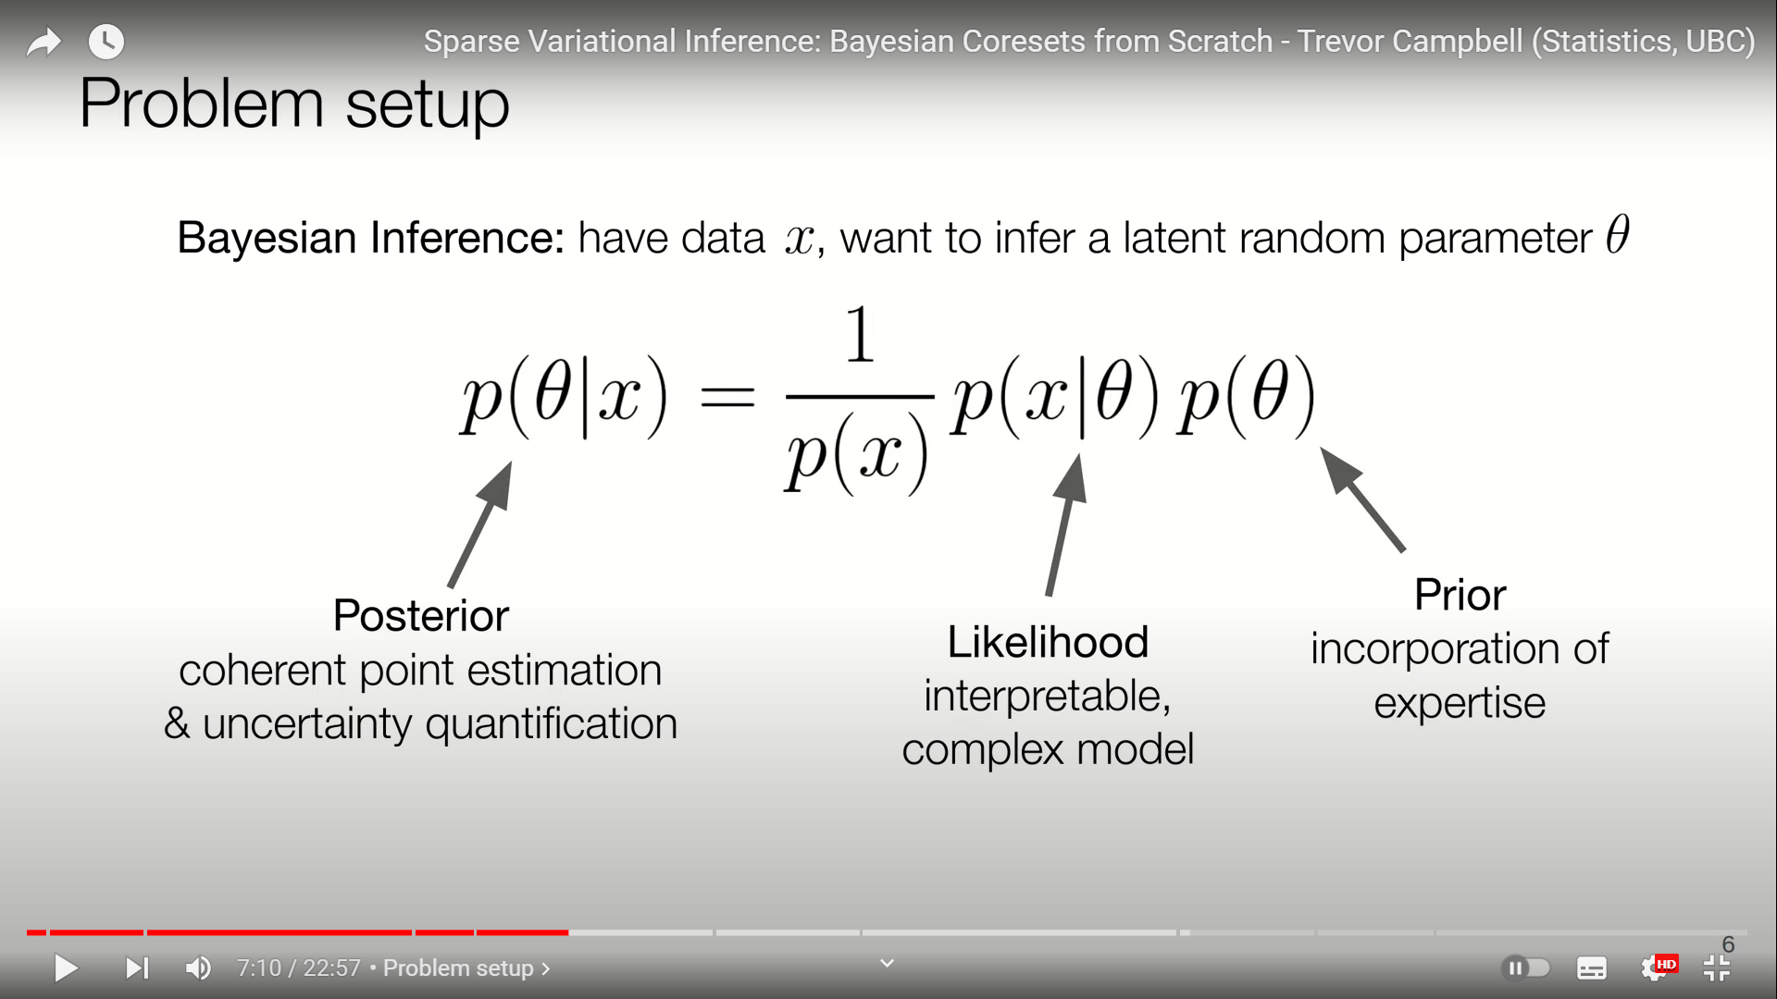

Bayesian Coreset
So the given a dataset X we need to infer the probability for the instant
Remember this?

Slide 11
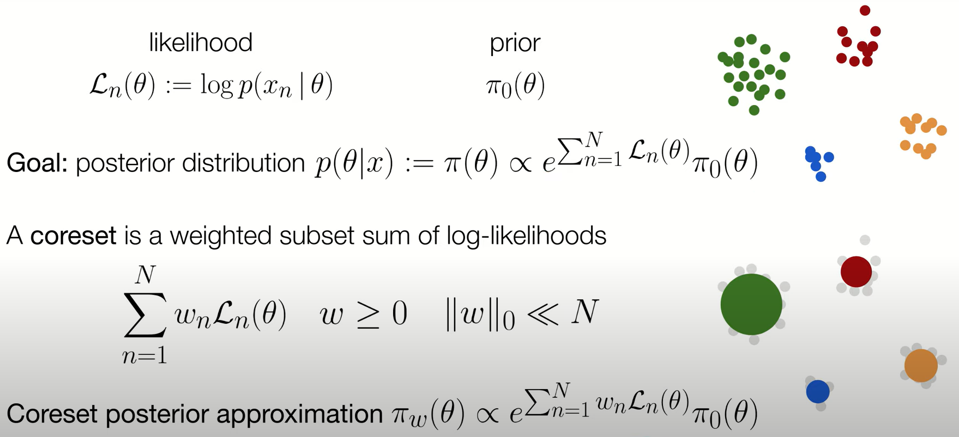
Log likelihood
Log likelihood
Coreset log likelihood

Slide 12
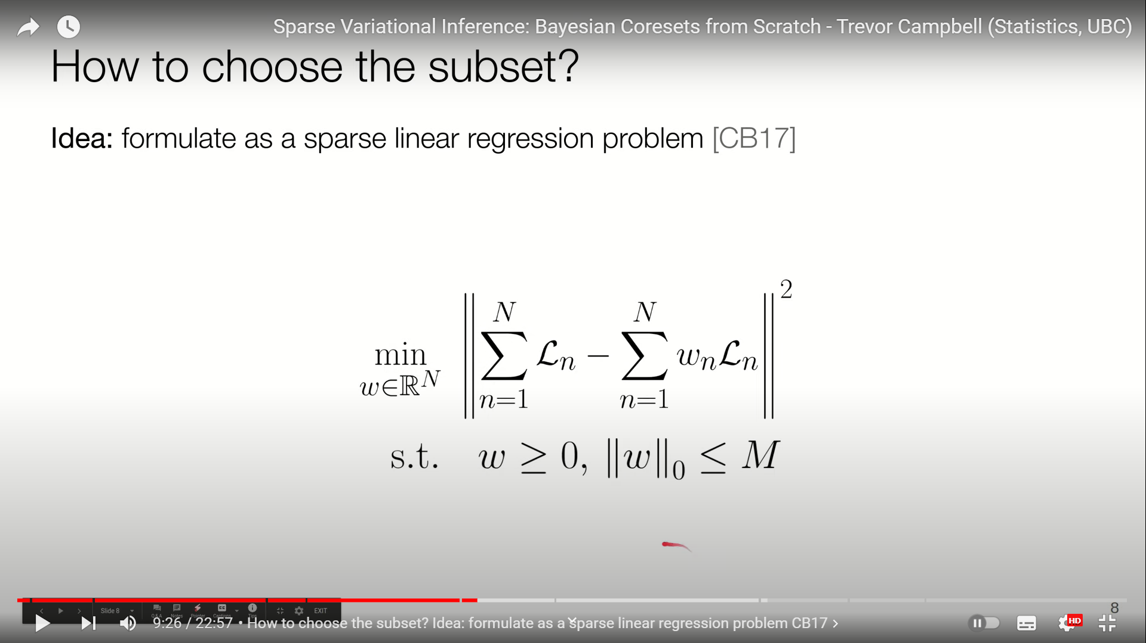
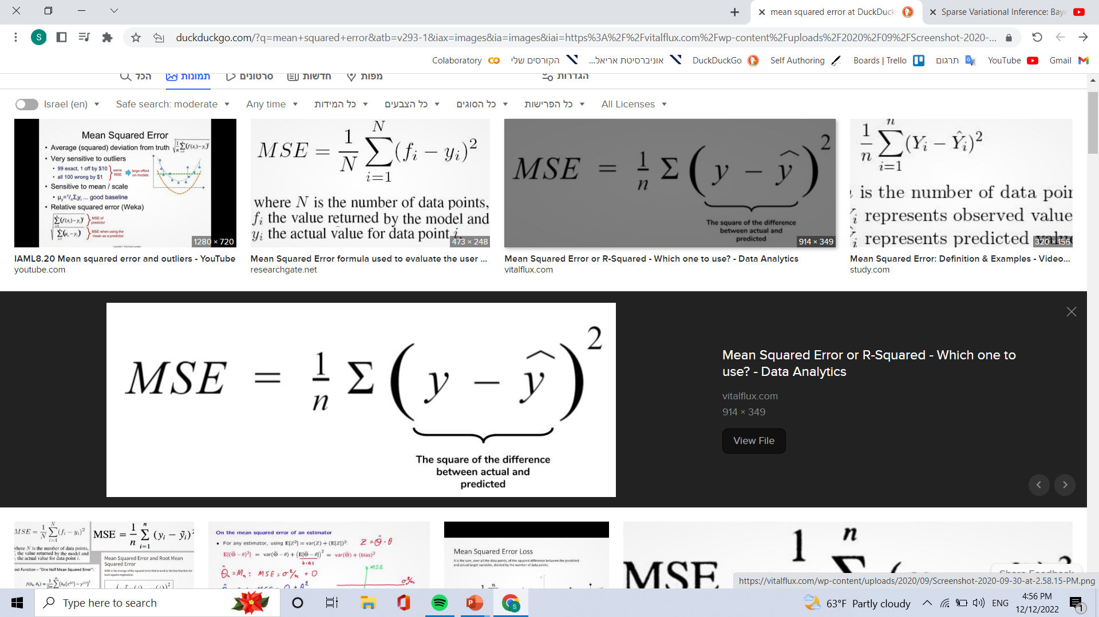
Choosing a subset using spars linear regression
Log likelihood
Coreset log likelihood
This is the min squared error looks familiar?
This can be any Hilbert space norm so the user need to choose a norm and compute/estimate it

Slide 13
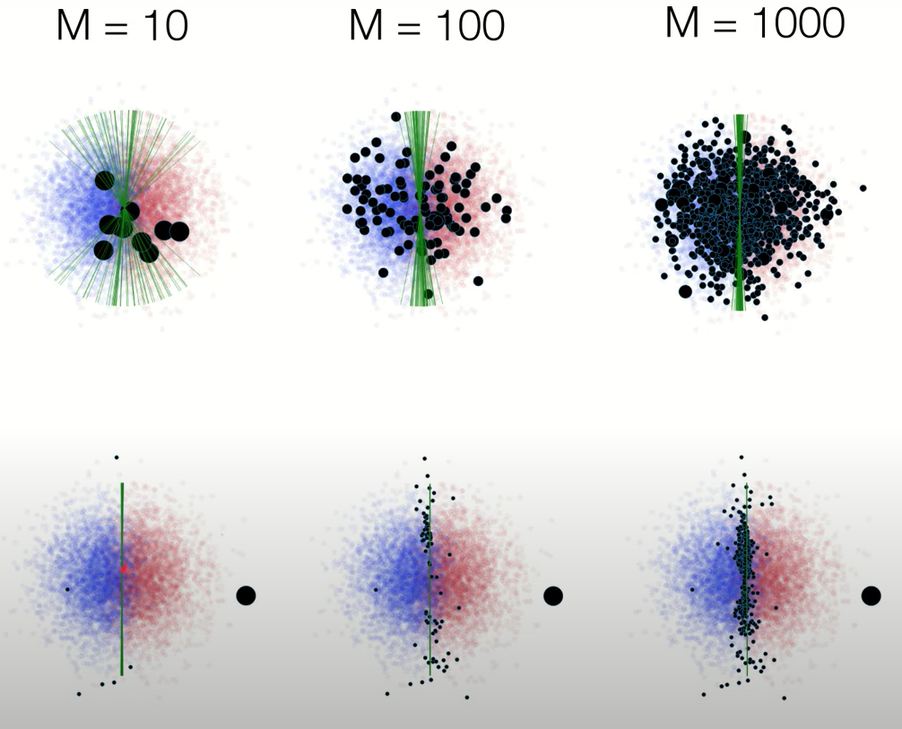
Choosing the norm have a huge effect on the quality of your Coreset.
Because this is how you mature your error and minimize it.
M is the number of points in the Coreset
The black points are the Coreset
the green lines represents the logistic plane created by different Coresets.
The upper graphs show randomly picked Coreset
The lower graphs show Coreset chosen by the MSE with a good norm selection

Slide 14
Questions

